Slide 1


Slide 2





According to the rating of the Independent, the Quality Assurance Agency for Education in InEU is recognized as one of the best multidisciplinary universities in Kazakhstan in 2020!
Click here
Atameken National Chamber of Entrepreneurs has compiled a rating of educational programs of universities in Kazakhstan, where 14 InEU educational programs received
a high expert rating
Click here
InEU has become the only private university in Kazakhstan, included in the QS rating of universities in Central Europe and Central Asia.
InEU visibility in ratings

Slide 3

Educational programs in ENGLISH LANGUAGE
51 bachelor
21 master
3 phd
Click here
Management
Informatics
For more information, click here ineu.kz
Jurisprudence

Slide 4
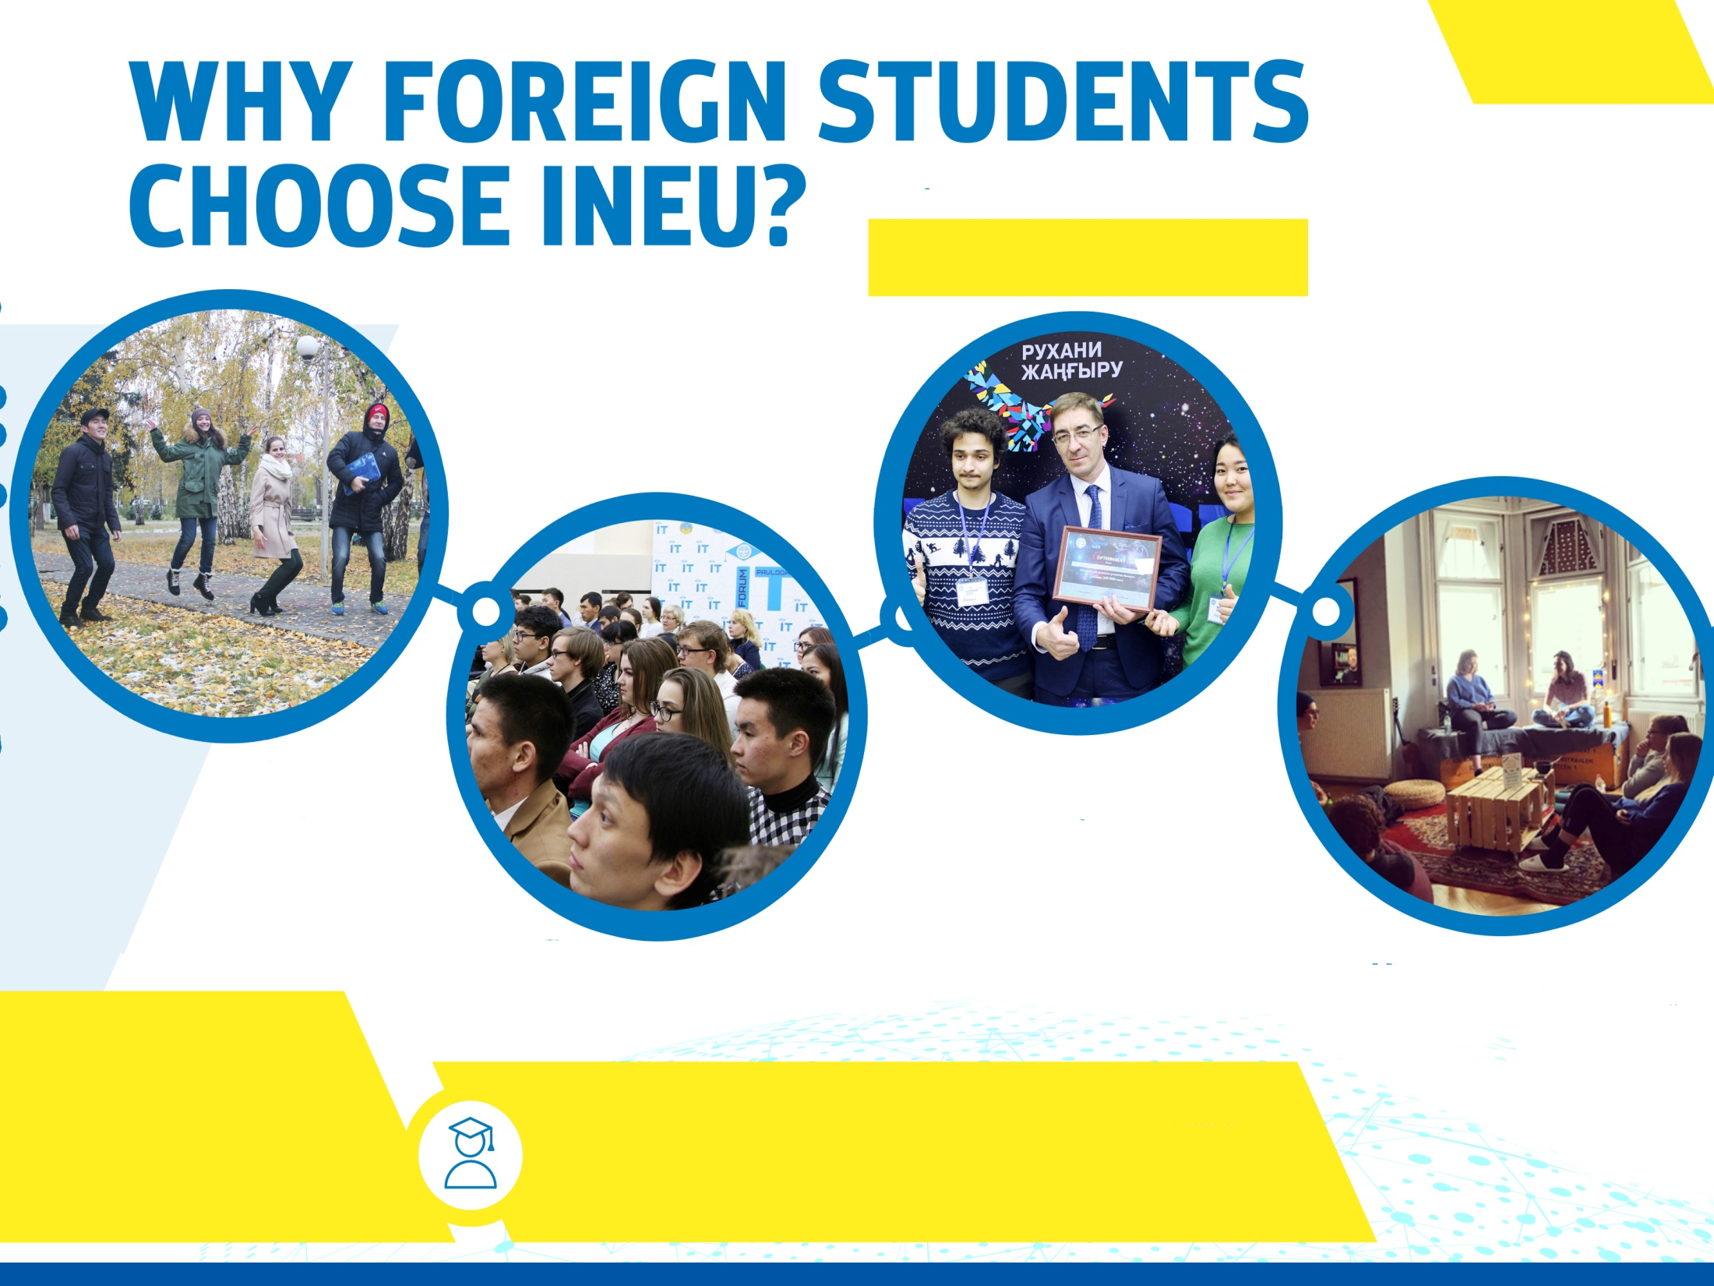
Your way to success
Student’s life
Interest clubs: literature club,
music club, volunteering
Computer classes
WIFI
Dormitory for students

Slide 5

Business courses
Programming and
it-education
Language Centers

Slide 6

Universities-partners for academic mobility programs
EXCHANGE STUDENTS’ PROGRAM
ASIA
10
EUROPE
28
USA
3
OTHER
16
Over 1000 students participated in AM programs
Click here

Slide 7

Establishing Master Programmes in HRM and Talent Development in Central Asia
For more information
Erasmus+ programs
DUAL EDUCATION FOR INDUSTRIAL AUTOMATIZATION AND ROBOTICS IN KAZAKHSTAN
For more information
Paving the way to interregional mobility and ensuring relevance, quality and equity of access
For more information
Modernization of higher education in Central Asia through new technologies
For more information

Slide 8

ineu.kz

