Slide 1
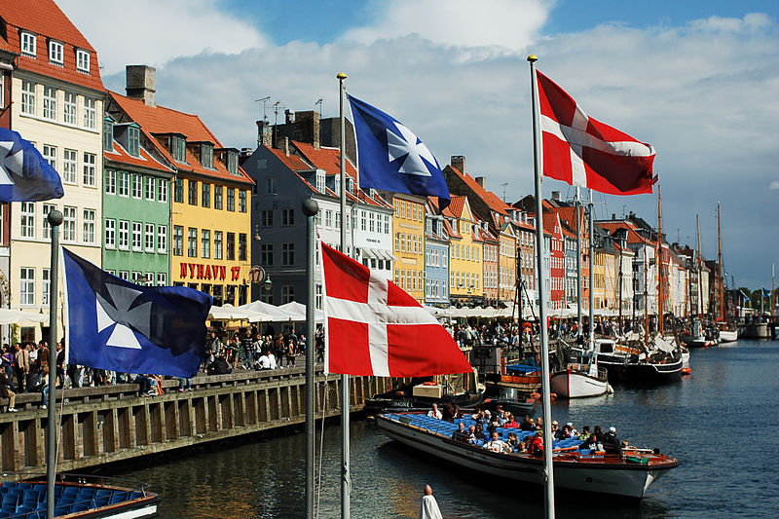
HOW TO BE HAPPY
http://freakonomics.com/podcast/happiness/

Slide 2
What makes you happy? How would you rate your happiness on a scale of 1 to 10?
Generally speaking, which factors contribute to people’s happiness?
Which countries rank among the happiest in Europe? Why?
What challenges do you face when moving to another country?

Slide 3
Hellen Russel (00:00 – 2:00)
What was Hellen’s job in the UK?
Why did Helen move to Denmark?
What challenges did she face when she moved to Denmark?
How did she feel:
before she moved? ………………………………………………………………….
at the beginnig of her life in Denmark? …………………..……………….
later? …………………………………………………………………..………………….

Slide 4
He decided to ………………………………. a career in television.
The ………………………….. of the traditional family firm is being threatened.
Manufacturers still build luxury cars with all the ………………………………………..
…………………………………., they are looking for ways to save money.
The meeting will …………………………….. as planned.
Amanda soon found her …………………………….. at the club.
Industries such as water, telecoms, and insurance have been ……………………………..

Slide 5
How does Denmark and other Scandinavian countries address the following factors? 11min -19 min
Education
Working hours
Parental leave
Healthcare
Obesity
Opioid epidemic
Government
Interpersonal trust
Leisure time
Service culture
Taxes and prices (21:15 – 23:45)

Slide 6
SOCIAL DEMOCRACY?
A theory or system of social organization in which all property is owned by the community and each person contributes and receives according to their ability and needs.
A political system according to which social justice and equality can be achieved within the framework of a market economy.
An economic, political, and social system in which property, business, and industry are privately owned, directed towards making the greatest possible profits for successful organizations and people.

Slide 7
Downsides
Listen to the podcast (26min-33min). What do the guest speakers say about the following?
migration, trust and happiness
suicide and happiness paradox
Explain the following terms: egalitarianism, diversity
http://freakonomics.com/podcast/happiness/

