Slide 1
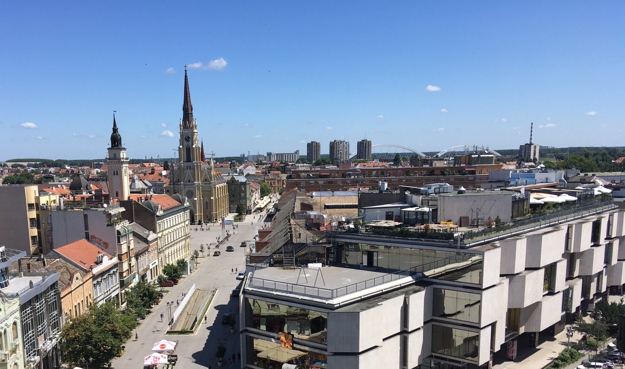
Continental Automotive Serbia d.o.o. Novi Sad
Intern in Finance Department
www.continental-corporation.com
Vehicle Networking and Information Division

Slide 2
Our company:
Continental develops pioneering technologies and services for sustainable and connected mobility of people and their goods. Founded in 1871, the technology company offers safe, efficient, intelligent and affordable solutions for vehicles, machines, traffic and transportation.
In 2021, Continental generated preliminary sales of €33.8 billion and currently employs more than 190,000 people in 58 countries and markets. On October 8, 2021, the company celebrated its 150th anniversary.

Slide 3
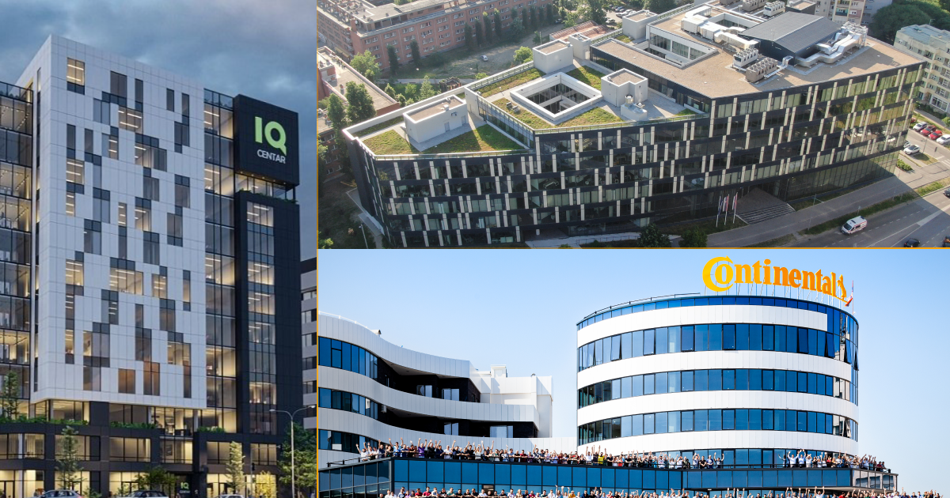
Research and Development Center Novi Sad (R&D)
In 2017, Continental opened a Research and Development Center in Novi Sad, where nearly 900 engineers work on the development of the most innovative technologies for cars and commercial vehicles. With attractive projects in the field of electronic devices for the vehicle cabin and systems and sensors for autonomous driving, the company has grown in less than six years of operation into one of the largest employers in the engineering sector of the automotive industry in the Republic of Serbia.
The company develops a wide range of products such as dashboards, radars, cameras, control units for remote monitoring of the vehicle's position and parameters, access systems based on vehicle access using smartphones or remote unlocking, a control unit for the control of electrical systems in the vehicle, a web-based infrastructure services, mobile applications and a major innovative project for highly autonomous driving for passenger cars and commercial vehicles.

Slide 4
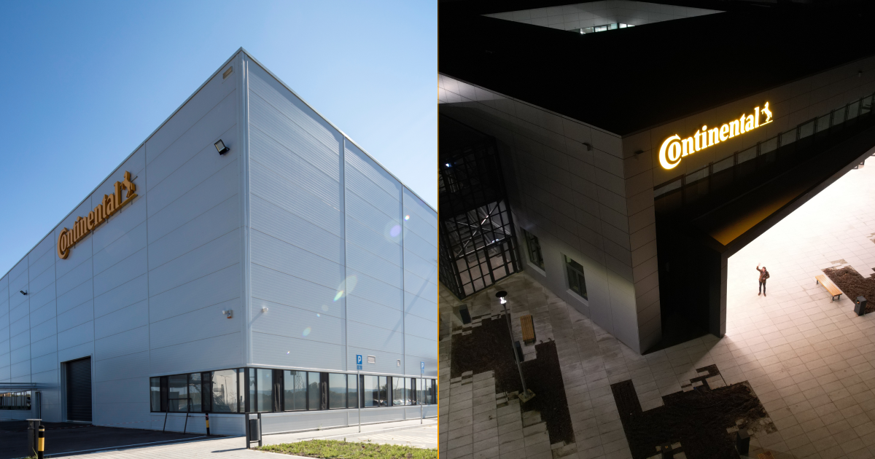
Factory in Novi Sad
In March 2021, Continental opened a factory in Novi Sad that produces advanced electronics such as dashboards and systems for displaying information and multimedia content for the automotive industry, which will employ at least 500 people.
The factory in Novi Sad belongs to the "User Experience" business unit, which employs over 15,000 people in 21 countries across Europe, America and Asia. We are leaders in creating innovative solutions for an outstanding user experience. Our strategy is to become the world's leading company in providing solutions in the automotive industry.

Slide 5
Intern in Finance Department – JOB DESCRIPTION
As a part of our team, you will have the opportunity to learn, improve and gain experience working in a company that is one of the leaders in the industry.
You will also be a part of a diverse team of experts and be involved in day-to-day business, undertake a variety of tasks.
The Internship Program is designed to last for a minimum 6 months.

Slide 6
RESPONSIBILITIES:
Learn to work in SAP
Evidence and import invoices SAP
Book invoices
Archiving of booked documentation
QUALIFICATIONS:
Final year or Bachelor’s Degree in Economy, Business Administration or related field
Fluent in English, both written and spoken
Team spirit, commitment, willingness to work in a service-oriented team
Good communication skills
Organizational skills
Proficient in Word, Excel, PowerPoint
WHAT WE OFFER:
A dynamic team in a globally active organization
Paid internship
Flexible schedule
Comprehensive training on the job
If you are interested in this internship position, you can send us your resume and letter of application in English language via email. Application deadline is 20.02.2023. short-listed candidates will be contacted.

Slide 7
THANK YOU FOR YOUR ATTENTION!

